Slide 1


LIVERAID
LIVER DISEASE
JUAN MIGUEL TRINIDAD
JONATHAN MUSNI
A STUDY IN LIVER DISEASES
LIVERAID

Slide 2
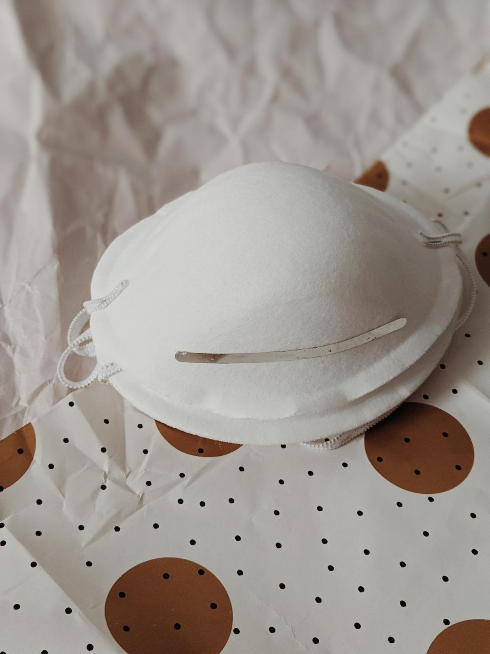

Points for discussion:
Topics and highlights
Introduction
Project Goals
Data Overview
Data Modelling
Conclusion
A STUDY IN LIVER DISEASES
LIVERAID

Slide 3


Liver Diseases
Hepatitis B, Hepatitis C, alcohol liver disease, nonalcoholic fatty liver, and cirrhosis
A STUDY IN LIVER DISEASES
LIVERAID

Slide 4


2,200,000
Total Deaths in 2017
Global Burden of Disease and Institute of Health Metrics and Evaluation
University of Washington
A STUDY IN LIVER DISEASES
LIVERAID

Slide 5


12th
Cause of death in United States
Centers for Disease Control and Prevention
A STUDY IN LIVER DISEASES
LIVERAID

Slide 6


GOAL
Understand the different factors associated with diagnosing liver disease and create a classification model that will aid medical professionals in diagnosing the presence of liver diseases.
A STUDY IN LIVER DISEASES
LIVERAID

Slide 7


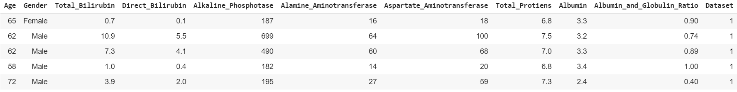
DATA OVERVIEW
Kaggle
583 rows
Patient Information
Chemical Compounds Information
1 = Sick
2 = Healthy
A STUDY IN LIVER DISEASES
LIVERAID

Slide 8
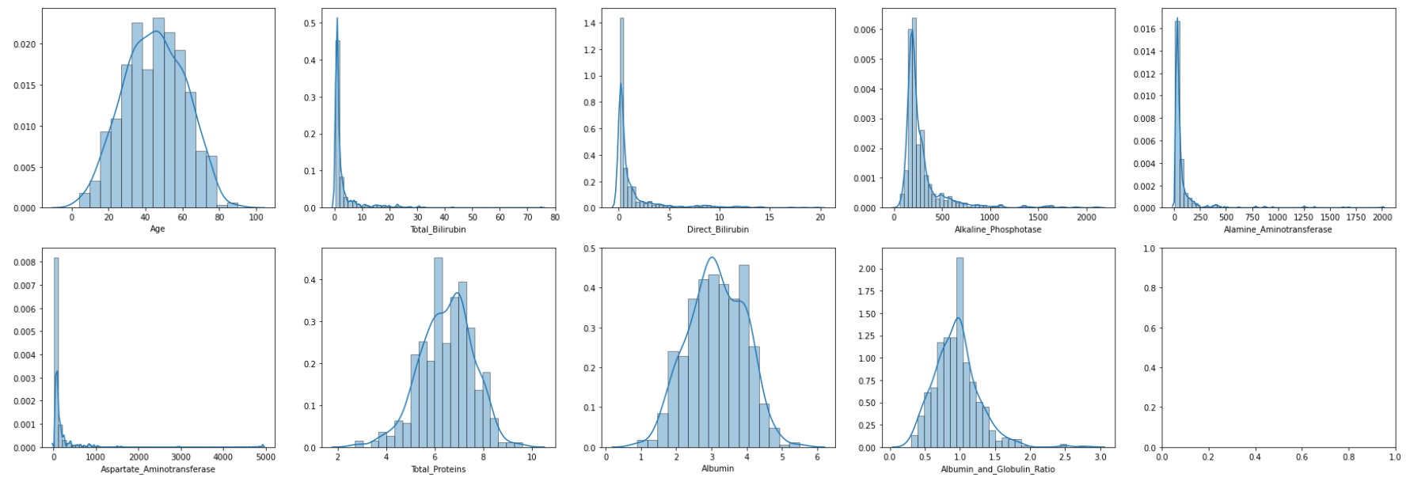
Data Distribution
A STUDY IN LIVER DISEASES
LIVERAID

Slide 9
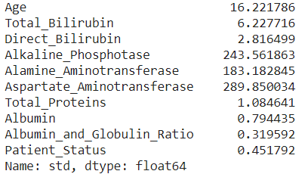
Data Distribution
A STUDY IN LIVER DISEASES
LIVERAID

Slide 10
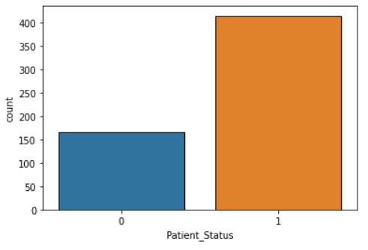

Data is imbalanced with 416 Patient Records compared to 167 non-liver patient
Data
Challenges
Imbalanced Data
Imbalance data can affect the results of our models. To address this problem, we statified our data and undersampled the majority class.
NON-LIVER PATIENT
LIVER PATIENT
A STUDY IN LIVER DISEASES
LIVERAID

Slide 11
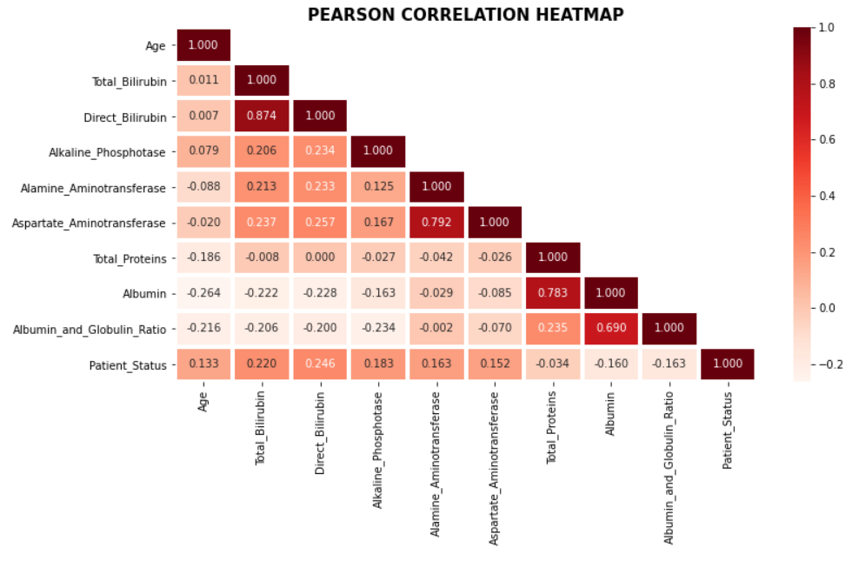
Data
Challenges
Multicollinearity
There are high corellated variables variables in our data.
A STUDY IN LIVER DISEASES
LIVERAID

Slide 12
Data
Challenges
Multicollinearity
There are high corellated variables variables in our data.
Dropped Albumin
Total_Bilirubin / Direct_Bilirubin
A STUDY IN LIVER DISEASES
LIVERAID

Slide 13
K-NN
Model Selection
Naive Bayes
Binary Classification, predict whether a person will most likely have a liver disease or not.
Decision Tree
Random Forest
XGBoost
Voting Classifier
A STUDY IN LIVER DISEASES
LIVERAID

Slide 14
Model Evaluation
TRUE POSITIVE
FALSE POSITIVE
Our models will be evaluated using different metrics.
Patients with liver disease that is predicted to have the disease.
Patients without liver disease that is predicted to have the disease.
FALSE NEGATIVE
TRUE NEGATIVE
Patients with liver disease that is predicted to have no disease.
Patients without liver disease that is predicted to have no disease.
A STUDY IN LIVER DISEASES
LIVERAID

Slide 15

Model Evaluation
TRUE POSITIVE
FALSE POSITIVE
Our models will be evaluated using different metrics.
Patients with liver disease that is predicted to have the disease.
Patients without liver disease that is predicted to have the disease.
F1 - Score
Precision
Recall
FALSE NEGATIVE
TRUE NEGATIVE
Accuracy
Patients with liver disease that is predicted to have no disease.
Patients without liver disease that is predicted to have no disease.
A STUDY IN LIVER DISEASES
LIVERAID

Slide 16

Model Evaluation
TRUE POSITIVE
FALSE POSITIVE
Our models will be evaluated using different metrics.
Patients with liver disease that is predicted to have the disease.
Patients without liver disease that is predicted to have the disease.
F1 - Score
Precision
Recall
FALSE NEGATIVE
TRUE NEGATIVE
Accuracy
Patients with liver disease that is predicted to have no disease.
Patients without liver disease that is predicted to have no disease.
A STUDY IN LIVER DISEASES
LIVERAID

Slide 17
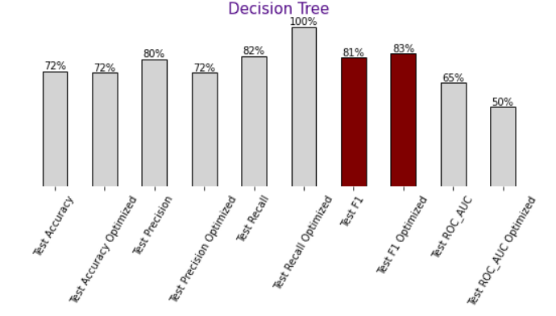
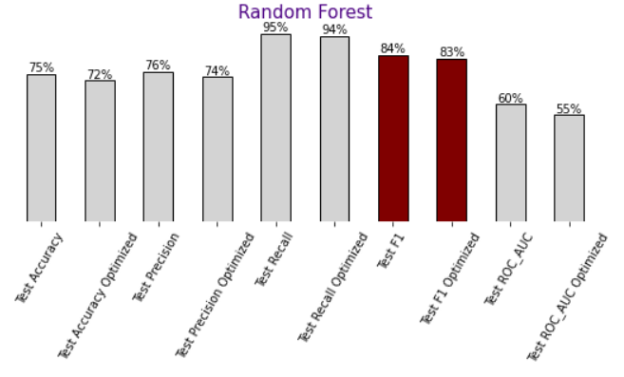
Model Training
Experiment 1: WIthout undersampling
A STUDY IN LIVER DISEASES
LIVERAID

Slide 18
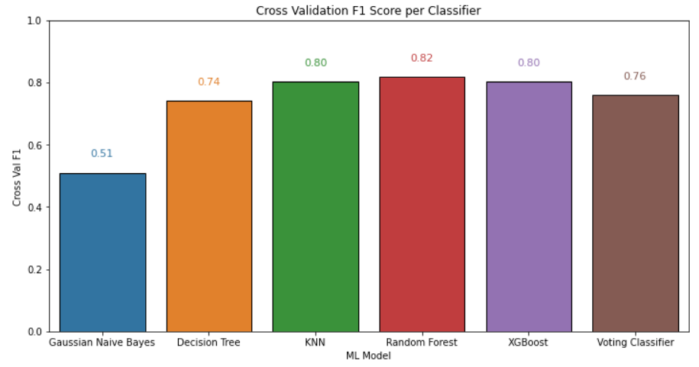
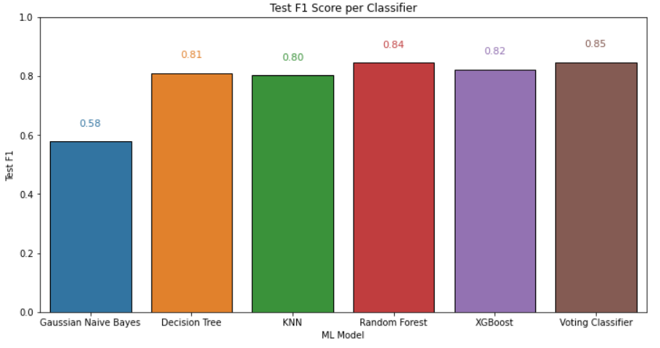
Model Perfomance
F1 Cross Validation vs Test Scores
Experiment 1: WIthout undersampling

Slide 19
Model Perfomance
Test F1 Scores
Experiment 1: WIthout undersampling

Slide 20
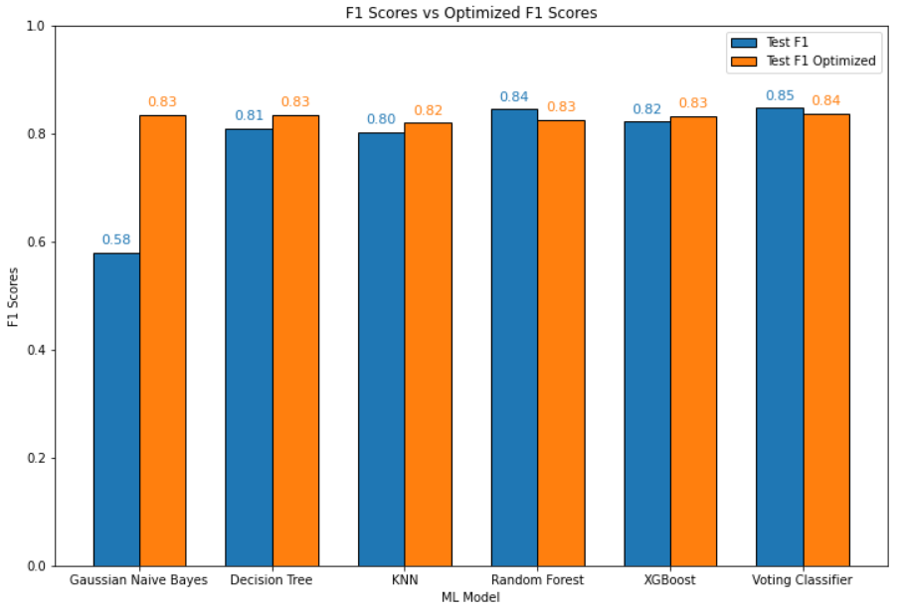
Model Perfomance
Optimized Test F1 Scores
Experiment 1: WIthout undersampling

Slide 21
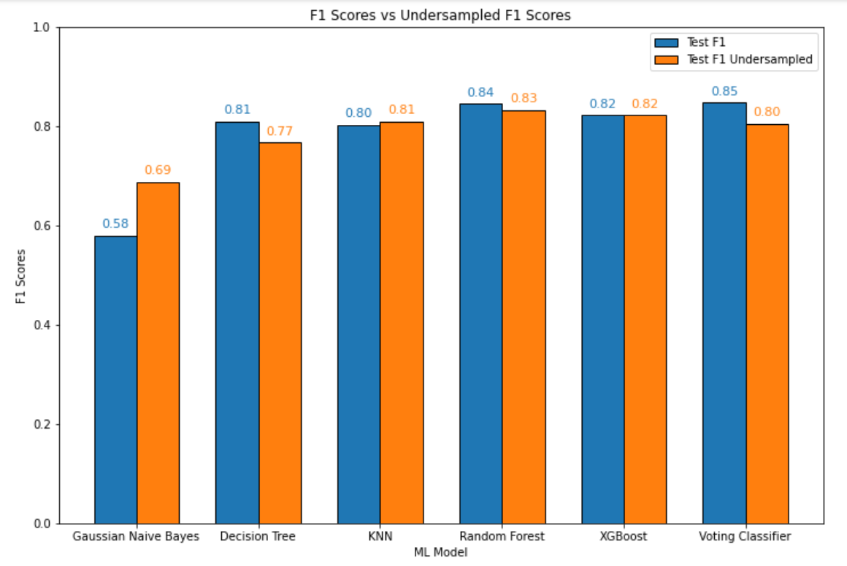
Model Perfomance
Undersampled F1
Experiment 2: With undersampling

Slide 22


Feature Improvements, Selection, Elimination
Predict Probablity of having the disease
Due to the data limitation that we have, having additional features would greatly increase our model's performance.
In addition to predict whether a person is sick or not. It would be good to include models that gives the probability(%) or having liver disease.
Future Work

Slide 23
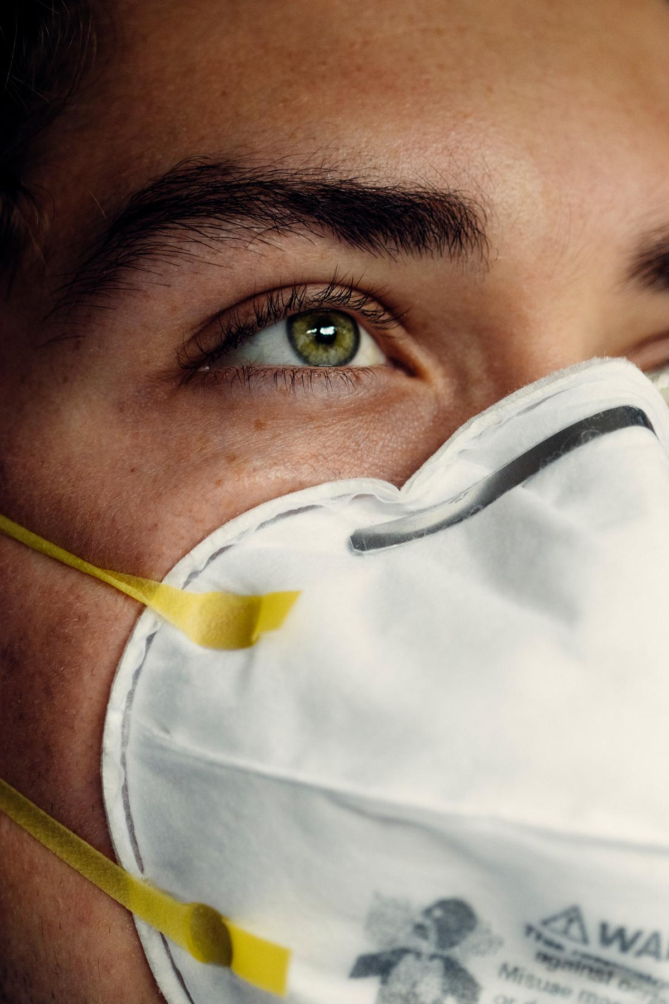

Hyperparameter Tuning Helps Improve Models
Hyper-parameter tuning helped us address insufficient and imbalanced data problems that we had and it also improved how our models performed.
Voting Classifier is the best model
After several experiments, Voting Classifier is the best model with 85% of F1 Score.
Conclusion
Our model does not replace a proper medical diagnosis
Our model only aims to aid a diagnosis of a liver disease., a proper diagnosis by medical professional is still required.
DEFEATING COVID-19

Slide 24
Questions?
JUAN MIGUEL TRINIDAD
JONATHAN MUSNI

Slide 25
Questions?
JUAN MIGUEL TRINIDAD
JONATHAN MUSNI

